Slide 1


ENGR 1111 Intro to Engineering: Civil Engineering Fall 2022 Part 3: GRIT & Time Management

Slide 2

Part 3: GRIT & Time Management
GRIT
Time Management
Procrastination
Manage Energy
Study Strategies
Test Taking Tips

Slide 3

GRIT
Part 3: GRIT & Time Management
“Capacity to dig deep and do whatever it takes– even sacrifice, struggle, and suffer– to achieve your goals”
Single most powerful predictor of student success- in and beyond school

Slide 4
GRIT
Part 3: GRIT & Time Management
Growth- Tendency to see fresh angles on situations and view success as a matter of effort, more than talent or smarts
Resilience- Bouncing back when you fall, and having a support network so you don’t fall as far
Instinct- Gut-level capacity to pursue the right goals in the most efficient and effective ways
Tenacity- Sheer persistence, relentlessly work at whatever you choose

Slide 5

Part 3: GRIT & Time Management

Slide 6
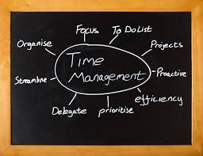
Time Management
Part 3: GRIT & Time Management
Develop a Gritty Mindset
Time Management Strategy
Resources – make sure you have the tools you need to complete the work/assignment
Routine- set schedule, how you complete the work
Resilience- respond effectively when things go wrong

Slide 7
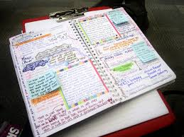
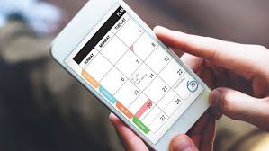
Avoid “Assignment Amnesia”
Part 3: GRIT & Time Management
Use a Calendar
Paper Planner
Web-based
Phone
Daily (task based)
Weekly/Monthly (assignments/tests/appointments)

Slide 8


Procrastination
Part 3: GRIT & Time Management
Avoiding/Delaying Starting a Task
Procrastination occurs when we are confused, intimidated, or overwhelmed by an assignment
Build milestones to combat procrastination
Procrastination can generate undue emotional, physical, and social stress

Slide 9
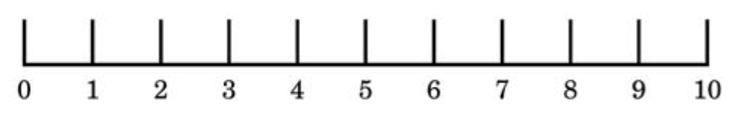
Question: Procrastination
Part 3: GRIT & Time Management
On the scale of 1 (very little) to 10 (very high) your typical level of procrastination when it comes to schoolwork.

Slide 10
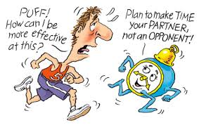
Manage Energy
Part 3: GRIT & Time Management
Time is only valuable if you have the energy to use it WELL
Physical and mental stamina, strength, sharpness, and focus
Circadian Rhythm – your personal highs/lows in sharpness throughout the day
Pay attention and use this to your advantage – Schedule classes & studying when sharp
Take breaks, run errands, etc. during lower periods
Energy Refill Activities

Slide 11
Manage Energy
Part 3: GRIT & Time Management
Energy Refill Activities
Go outside
Laugh
Sleep
Socialize
Eat healthy
Move (exercise)
Stretch
Drink water

Slide 12
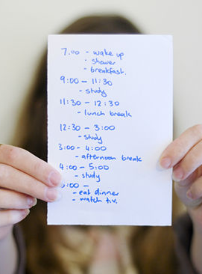
Studying Strategies
Part 3: GRIT & Time Management
When?
What?
Study for tests early – Short blocks of time – 1 hour
In-between classes
Unexpected free time
Peak performance time
Class Notes
Listen for clues in class – Profs. often say “Write this down,” “This will be on the test.”
Readings & Assignments
Look at course objectives

Slide 13
Question: Study Habits
Part 3: GRIT & Time Management
Cramming 4 hours the night before the test is proven to yield better test results than studying in increments of 30 minutes to an hour in days leading up to the test.
True
False

Slide 14
Question: Studying for tests
Part 3: GRIT & Time Management
Where can you look for clues on what material to study for tests?
In the course objective found in the syllabus
Ask the instructor during office hours
Listen for the instructor to say something like, “this will be on the test.”
All of the Above

Slide 15


Studying Strategies
Part 3: GRIT & Time Management
Where?
Have a study location (or a few)
Location where you can focus free of distractions
Quiet
Light Background Noise

Slide 16
Question: Study Location
Part 3: GRIT & Time Management
Where is your favorite college study location?

Slide 17

Active Studying
Part 3: GRIT & Time Management
Study to LEARN not to just REMEMBER
RE-Reading Text & Notes– Research shows it’s not that effective
Research Suggests ACTIVE Studying
Rewriting Notes – or Summarizing Notes
Explain Concepts to someone else – Study Groups
Make Visual Representations
Reworking Problems
Predict Test Questions
Make a Cheat Sheet (for study purposes— not to cheat)

Slide 18
Question: Active Studying
Part 3: GRIT & Time Management
Active studying is the most effective way to study. Which of the following is an example of active studying?
Rereading text
Rereading notes
Rewriting notes
Explaining concepts to someone else who is not familiar with the topic
C and D

Slide 19

Study Groups
Part 3: GRIT & Time Management
Suggested no more than 4-5 people
Discuss expectations
Access to more notes
Other perspectives/ explanations
Built in support group/ resources

Slide 20



Test Taking Strategies
Part 3: GRIT & Time Management
Get your body ready
Eat, sleep, and good attitude
Set the stage
Pack supplies- pencil, calculator (with backup batteries), scantron (if needed), cheat sheet (if allowed), watch
Test Time
Look over the ENTIRE exam first (look at allocation of points and types of questions)
Read the directions on the first page
Work easy questions first – mark the unanswered questions and come back
Answer all questions (credit is credit….even partial)
Leave 5-10 minutes to check your work

Slide 21
Question: Take Home Tests
Part 3: GRIT & Time Management
Which of the following statements is true of take home tests?
You do not need to prepare
They are typically more difficult and time consuming than a regular test
You are free to use any resource
You are allowed to give help or receive help from other students in the class

Slide 22

Part 3: GRIT & Time Management

Slide 23
ENGR 1111 Intro to Engineering: Civil Engineering Fall 2022 Part 3: Time Management

Slide 24
ENGR 1111 Intro to Engineering: Civil Engineering Fall 2022 Part 4: Money

Slide 25
Question
If $20,000 came to me unexpectedly, my first IMPULSE would be to:
Spend it on things I want, including gifts for others.
Immediately put it somewhere safe so I wouldn't spend it needlessly.
Put off making any decisions until I am less overwhelmed.
Figure out ways of investing the money to get the best possible return.
Give most of it away to charitable organizations that can make the world a better place

Slide 26
Money & College
Scholarships
CEAT Schoalrships
Financial Aid – Scholarships and Waivers
Internships
$15 - $30/hour
Free or subsided housing
Co-Operative Education (Co-Op)
Three semester work/education rotation with one company
1 full year of work experience
Experience counts toward licensure
Official part of transcript
Report required
Student Services – Co-Op
Part-time Jobs
GOAL: LEAVE COLLEGE AS CLOSE TO DEBT FREE AS POSSIBLE!
TARGET: CAP TOTAL LOANS AT EXPECTED ANNUAL SALARY OR LESS!

Slide 27
Question
Cooperative Education (Co-op) is an unpaid work experience that generally has no relevance to your major field of study.
True
False

Slide 28
Question
The calendar that provides important dates throughout the semester, including due dates for tuition payments and dropping classes is
Daily calendar
Class schedule
Academic calendar
Monthly calendar

Slide 29
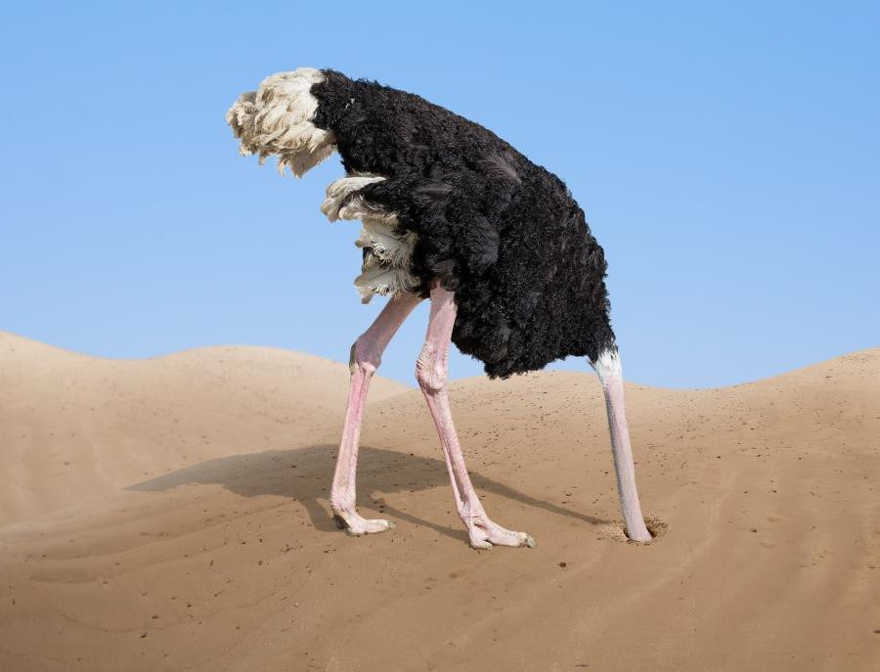
Money AFTER College
Make a monthly budget
Put your NEEDS before your WANTS
Live CHEAP your first year after graduation to figure out your true
expenses
Plan for unexpected expenses
GOAL: FACE YOUR FINANCES HEAD-ON, BE ENGAGED AND INTENTIONAL

Slide 30
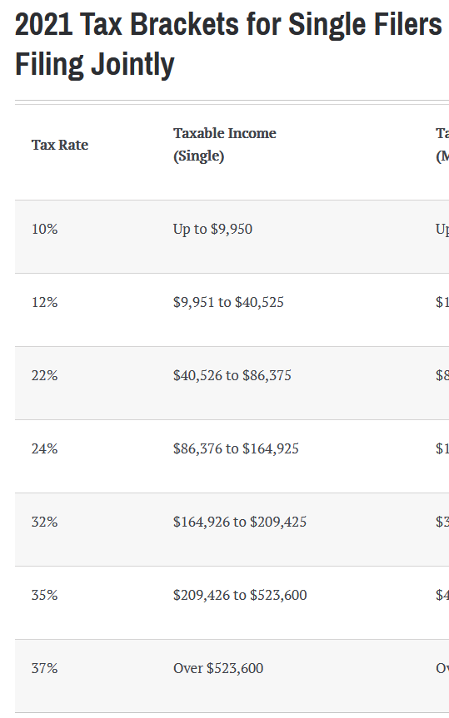
Money AFTER College
Monthly Salary Breakdown
Taxes
Federal Taxes
State Taxes
FICA
Medicare
Pre-tax Deductions
Medical Insurance
Vision Insurance
Dental Insurance
Retirement
Parking
Post-tax Deductions
Additional Retirement
Life Insurance
Long-term Disability
Plan for your Net Salary to be 60-70% of your Gross Salary
GOAL: FACE YOUR FINANCES HEAD-ON, BE ENGAGED AND INTENTIONAL
Tax Brackets and Rates, 2021 [Online Table].

Slide 31
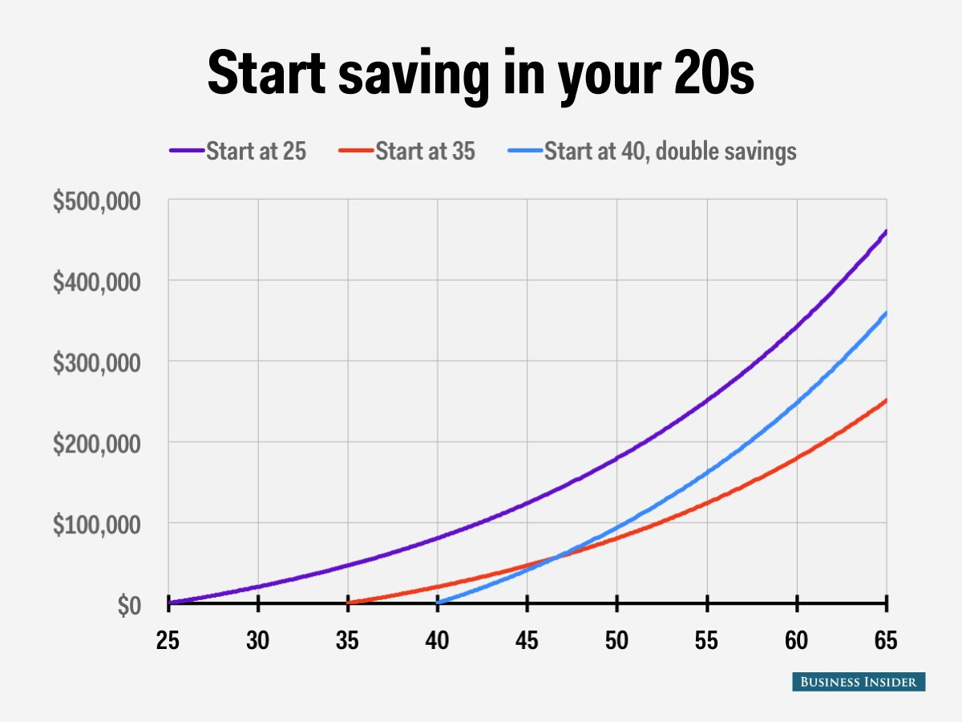
Investing & Saving
Manage your own money – take control
Time Value of Money
Inflation
Interest Rate Return
Retirement Planning – Start Now!!!
Retirement Vehicles
Roth IRA
Traditional IRA
401K
Maximize any contributions your
employer makes to retirement!
15-25% of your income should be directed to retirement and savings.
GOAL: EDUCATE YOURSELF ABOUT HOW TO MANAGE YOUR OWN MONEY
Investing for Beginners, Investing for Dummies

Slide 32
Question
If anyone you do not know contacts you through email to ask you to send bank details, what should you do?
Give them the details
Ask them to contact through phone
Delete the email

Slide 33


Building Wealth
A high income is not the same thing as wealth
You can have lots of things or financial freedom…. NOT BOTH!
Be careful of the company that you keep – they might be too expensive for you.
GOAL: FINANCIAL INDEPENDENCE ALLOWS YOU TO BREATHE EASIER AND WEATHER ANY STORM!

Slide 34

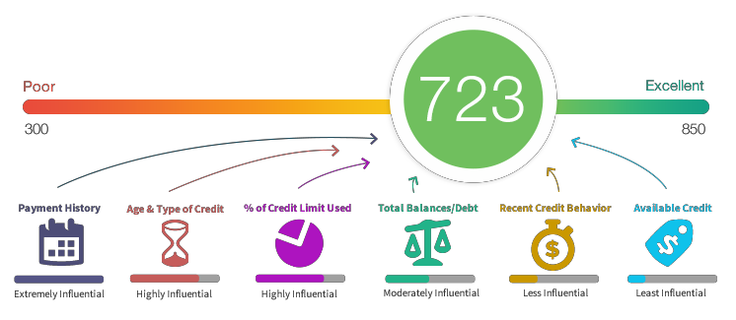
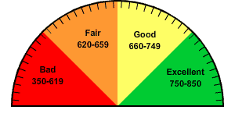
Credit Cards and Debt
Debt Eliminates Choice. PERIOD.
Good debt vs. bad debt?
Credit Cards – A dangerous game
Credit Score
What is it?
Why is it important?

Slide 35
Question
Which of the following best represents a need, not a want?
Cable
Rent/Mortgage
The latest fashion trends
Car Payment
Unlimited text message plans

Slide 36
ENGR 1111 Intro to Engineering: Civil Engineering Fall 2022 Part 4: Money

